Slide 1


Module 5. Lesson 5.
The Shooter game.
Part 1
Link to guidelines

Slide 2

Module 5. Lesson 5. The Shooter game. Part 1
Discussion:
New request

Slide 3
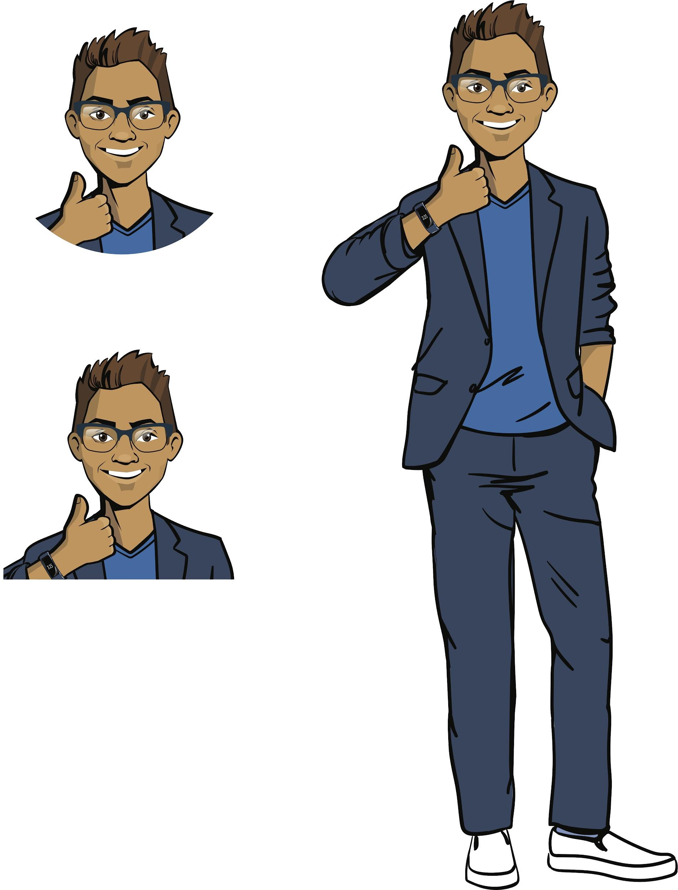

Developers, we’ve got a new request!
The employees of our department start working on the Shooter game.
Just like the last time, the game designers have thought through the game scenarios, and the artists have prepared pictures for the background and sprites.
Now we have to program the functionality.
Let’s examine the technical task!
Discussing
work tasks
Cole,
senior developer

Slide 4
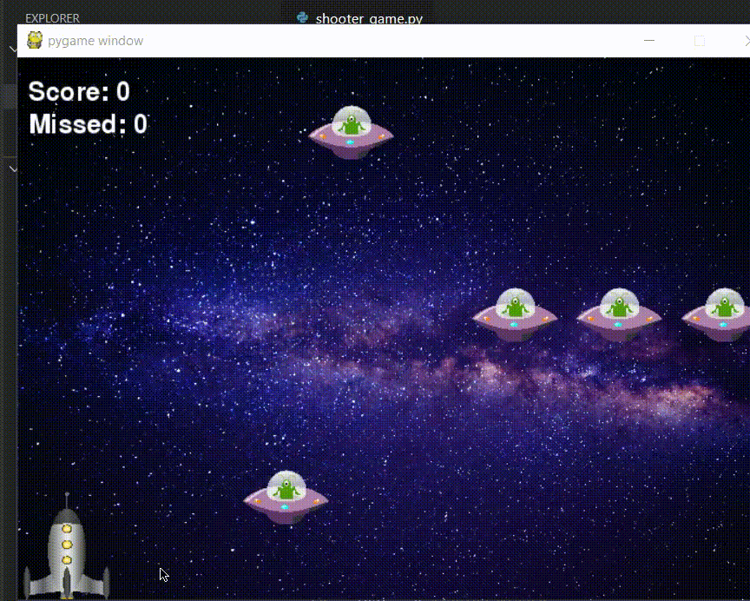
Technical task
Goal — to program the functionality of the Shooter game.
The expected look of the game:
Discussing
work tasks

Slide 5
Technical task
Goal — to program the functionality of the Shooter game.
Requirements:
Key control for the player:
movement — the Left and Right arrow keys;
shooting — the Spacebar.
Enemies for the player:
enemies appear at random at the top of the screen and move downward at different speeds;
there are 6 enemies on the screen at any given time.
The player wins if they destroy 10 enemies.
The player loses if they miss 3 enemies
*or collides with one of them.
Discussing
work tasks

Slide 6
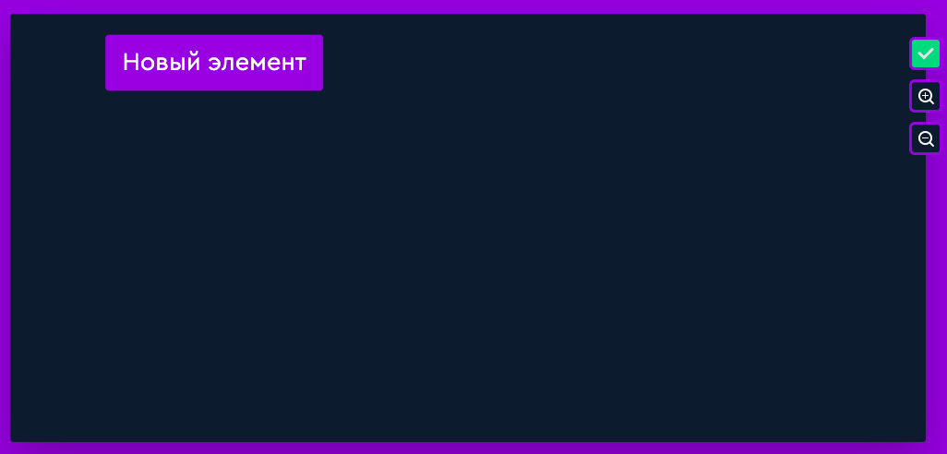
Planning the work: mind map
Let's make a mind map for the project:
New element
Discussing
work tasks
Link to level
Open the task with the map on the platform. What will be the content of the game?

Slide 7
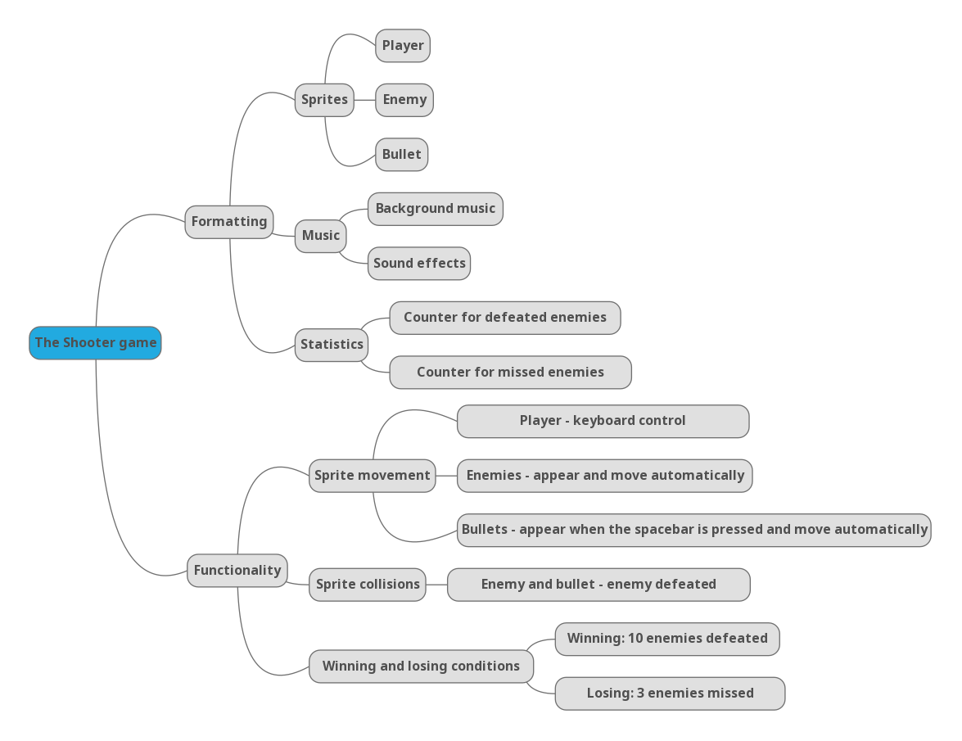
Planning the work: mind map
Mind map for the project from the developer Cole:
The map for this game looks hard!

Slide 8
Planning the work: mind map
Mind map for the project from the developer Cole:
So far, the most obscure part of the game is creating lots of enemies and bullets and controlling them...

Slide 9
Planning the work: mind map
Mind map for the project from the developer Cole:
Despite the fact that we know how to work with text, it is not clear how to create and implement statistics counters.

Slide 10
Planning the work: mind map
Mind map for the project from the developer Cole:
For starters, we can create a game template with a background, music, and a controlled player.

Slide 11
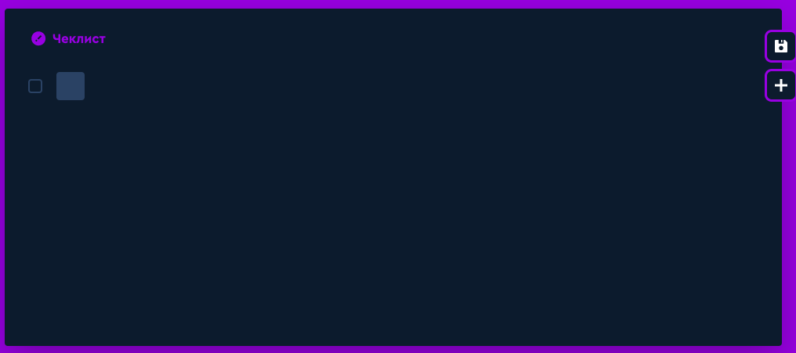
Planning the work: checklist
We will fill in the checklist as the project tasks are allocated:
Discussing
work tasks
Link to level
What tasks are we implementing today?

Slide 12
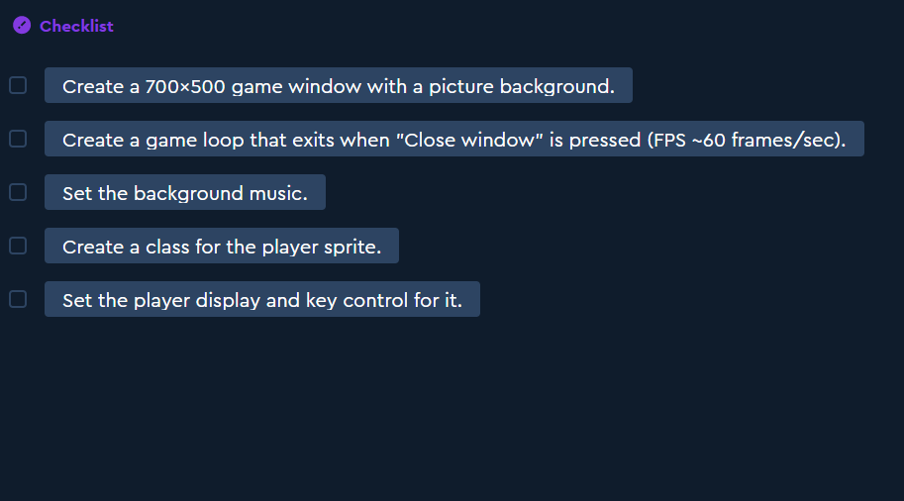
Planning the work: checklist
Cole has suggested checklist of tasks for today:
Discussing
work tasks
We know almost all the stages from the previous project!

Slide 13
The goal of the work day is
to program the template for the Shooter game.
The template should include the game window, background, music, and a controlled player.
Today, you will:
Discussing
work tasks
Recall how to create games using pygame.
Recall how to create child classes (including from the Sprite class from pygame).
Program a game template with a background, music, and a controlled player.

Slide 14

Module 5. Lesson 5. The Shooter game. Part 1
Qualifications

Slide 15
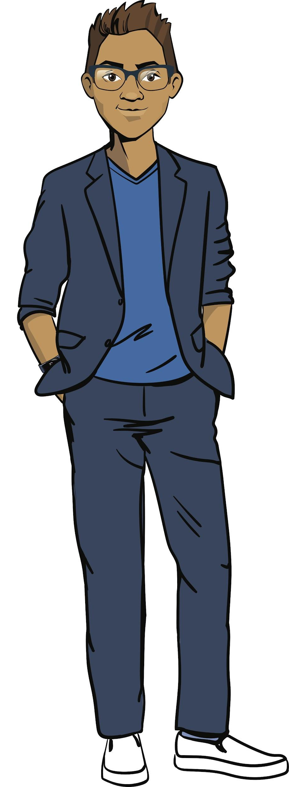
Demonstrate your knowledge
of the basics of game creation
and object-oriented
programming
Qualifications

Slide 16
How do we create a game window?
How do we set a background picture?
What if the picture doesn't fit the window?
Qualifications

Slide 17
Creating a template with a background
Note. The picture should be in the project folder.
Command | Purpose
window = display.set_mode((700, 500)) | Create the window size: (width, length)
display.set_caption("Catch") | Set the window title
background = transform.scale( image.load("background.png"), (700, 500) ) | Create an object for the image, adapt the picture size to the window parameters
window.blit(background,(0, 0)) | Display the background picture in the window
Qualifications

Slide 18
How do we set background music to the game?
What music file formats can we use?
Qualifications

Slide 19
Background music
All operating systems support these formats: ogg and wav.
Command | Purpose
mixer.init() | Enable the use of Mixer.
mixer.music.load('space.ogg') | Load music files for background playback.
mixer.music.play() | Start playing background music.
Qualifications

Slide 20
What is a class?
How do we create a class?
Qualifications

Slide 21
Creating classes
To create a class, we need to do the following:
list in the constructor the properties that determine the features of the class instance;
list the methods for managing the instance.
class Application():
def __init__(self, title_text):
self.title = title_text
def print_info (self):
Class name
A special constructor function that creates an instance of the class with the specified properties.
Qualifications
Value
Property name
Value
Method name
Action with the object and properties
__init__
Action with the object and properties
Two underscores.

Slide 22
What is the meaning of inheritance?
How do we create a child class for the Sprite class from PyGame?
Qualifications

Slide 23
Superclass and child class
Class inheritance helps us transfer all the skills previously written for a more general class into another, more private class, the child class.
class Application( ):
def __init__(self, ):
super().__init__( )
def print_info (self):
Inheritor name
Superclass name
Value
Qualifications
Referring to the superclass constructor.
Value
Method name
Action with the object and properties

Slide 24
Example: GameSprite is a child class of Sprite
The child class of Sprite should contain:
the properties image (picture) and rect (sprite frame);
the method reset() and a parent class constructor.
class GameSprite(sprite.Sprite):
def __init__(self, player_image, player_x, player_y, player_speed):
super().__init__()
self.image = transform.scale(image.load(player_image), (65, 65))
self.speed = player_speed
self.rect = self.image.get_rect()
self.rect.x = player_x
self.rect.y = player_y
def reset(self):
window.blit(self.image, (self.rect.x, self.rect.y))
Qualifications

Slide 25
Qualifications confirmed!
Great, you are ready to brainstorming and working on your tasks!
Qualifications

Slide 26

Module 5. Lesson 5. The Shooter game. Part 1
Brainstorming:
The Shooter game
template

Slide 27
Creating a game template
Let's program the game scene with background music:
Brainstorming
Tasks for the first half of the work day

Slide 28
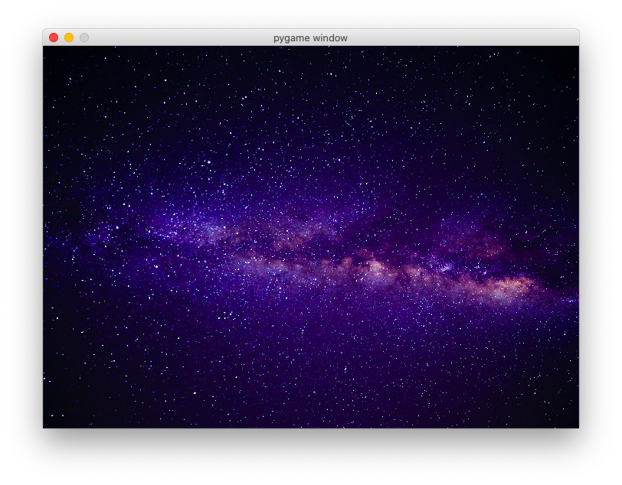
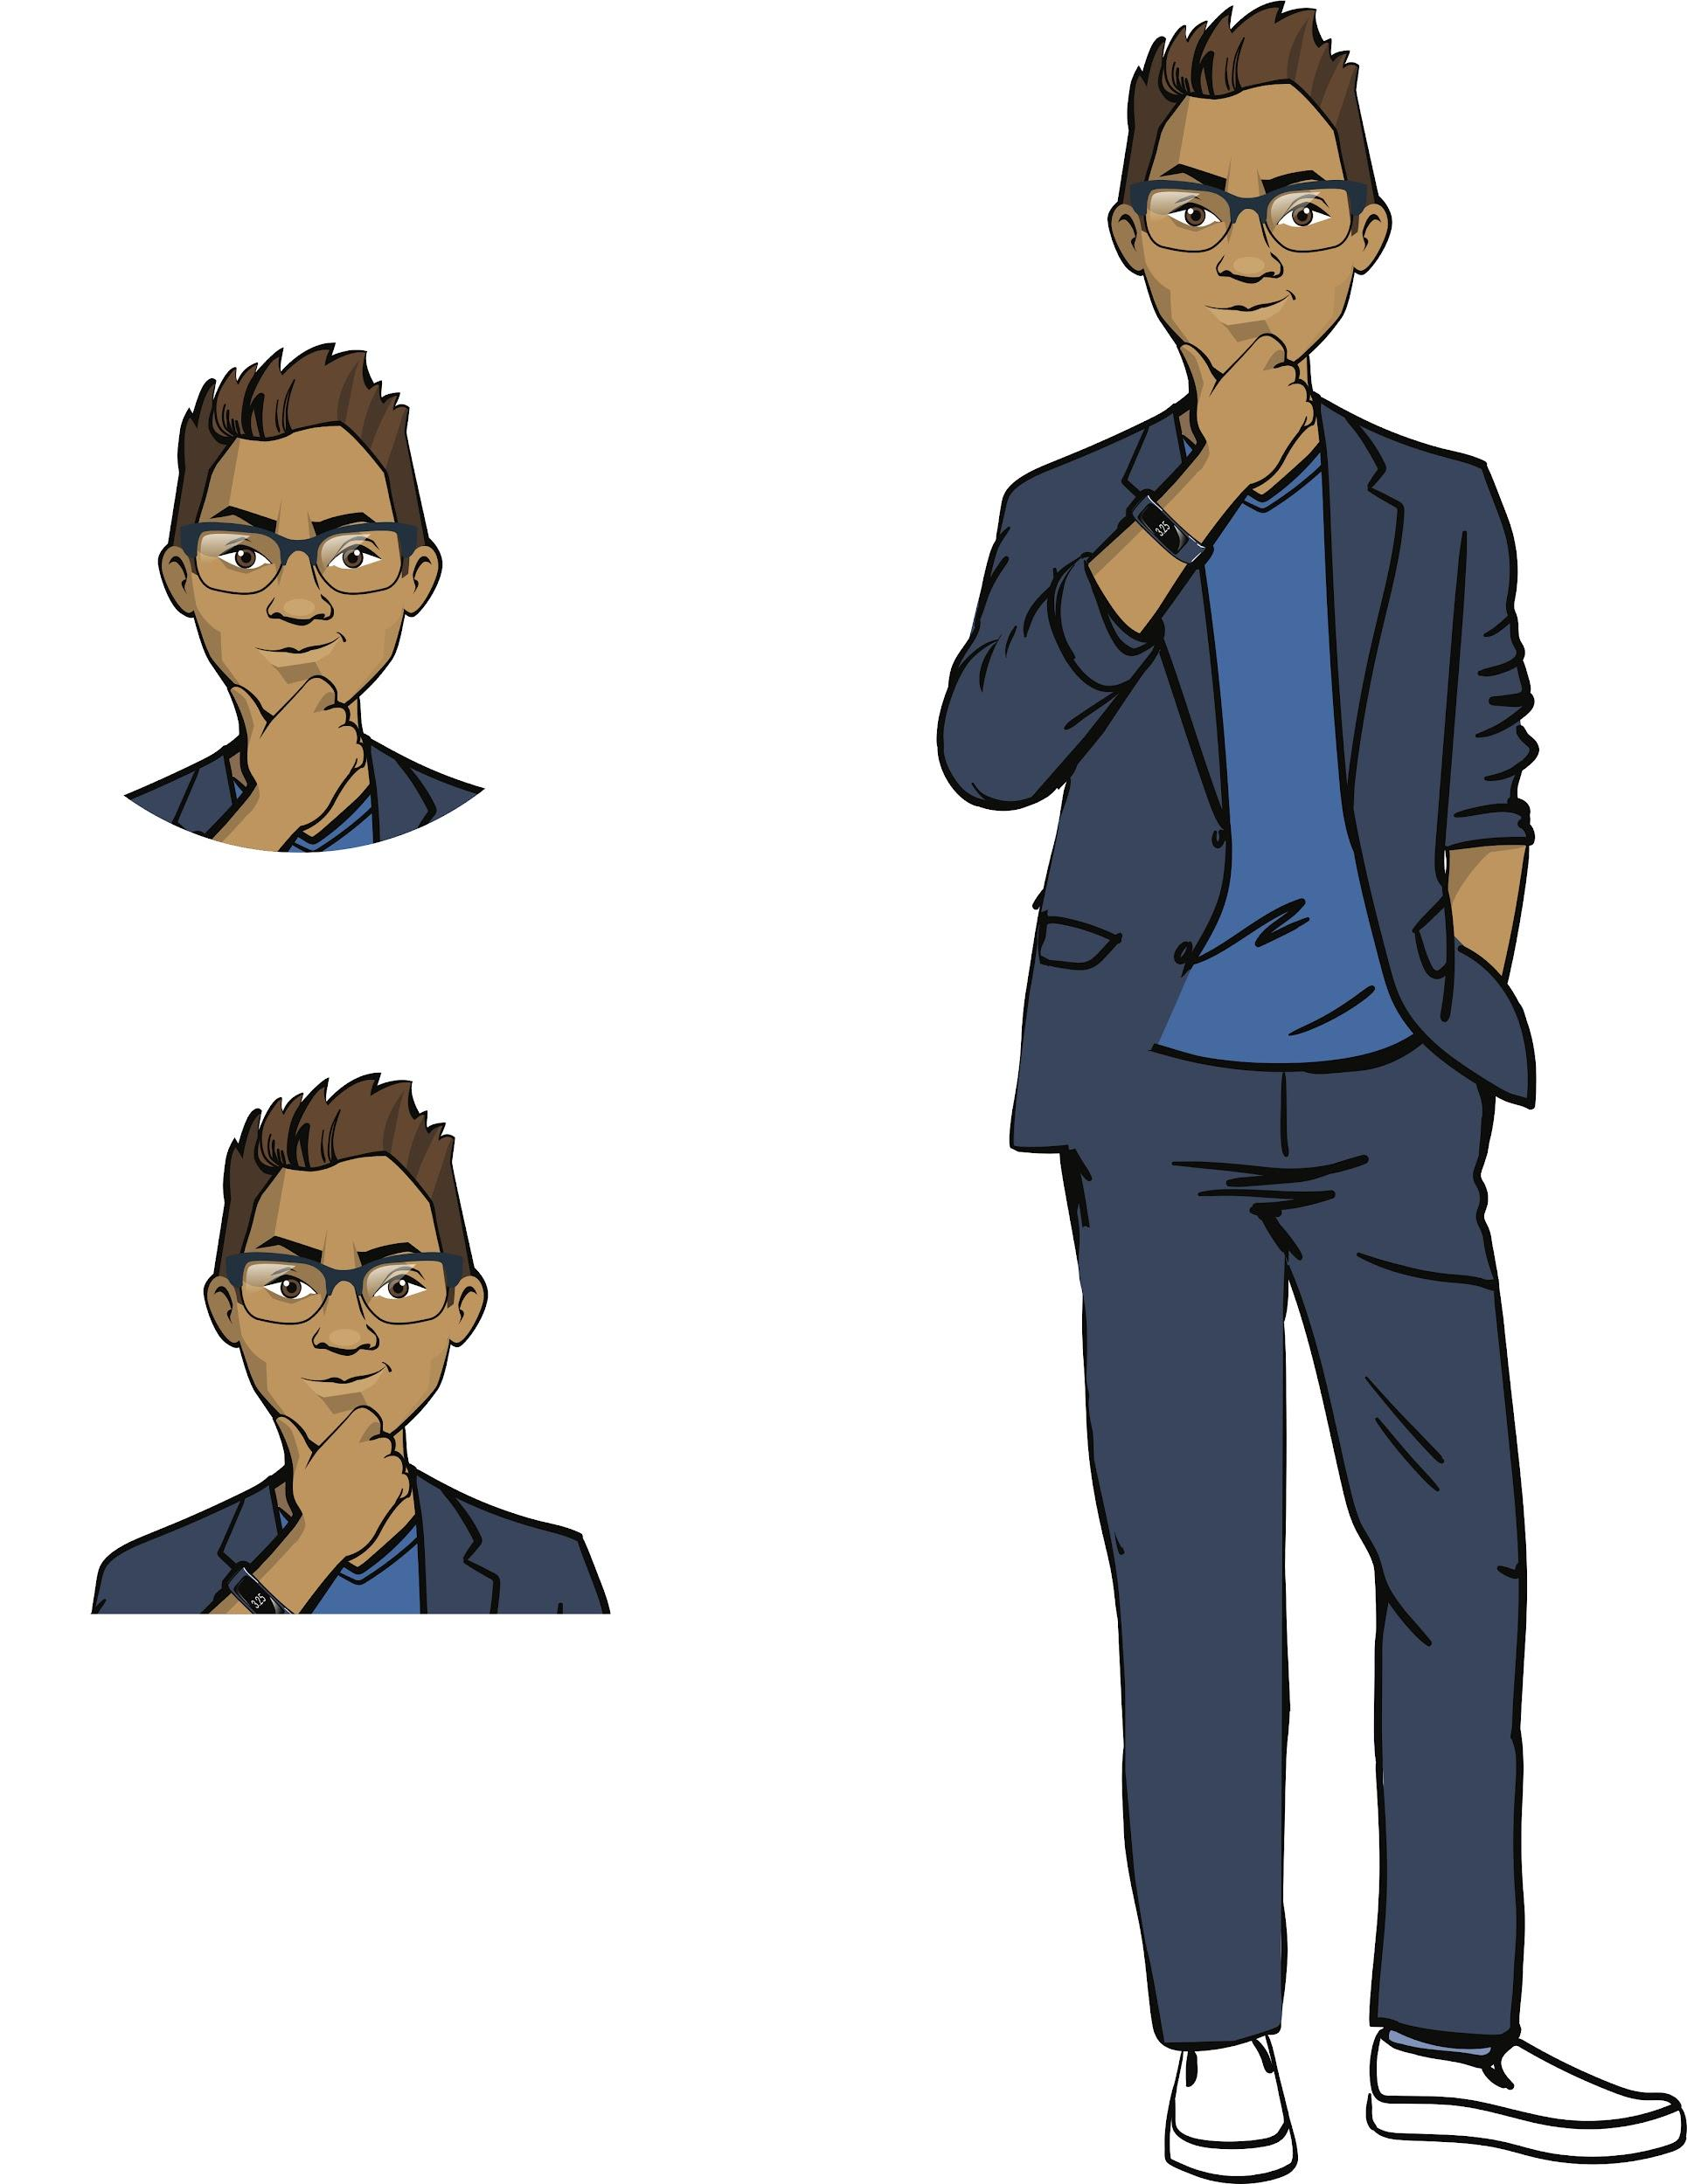
How do we program a game window with a picture and background music?
galaxy.jpg
Background music
space.ogg
Brainstorming

Slide 29
Game loop for the Shooter game
Create and run the music
Create a window with a background
run = True — game is going
No
run not equal to False?
Yes
Brainstorming
Display the window with the background
Refresh the frame
No
Is Close Window’ button pressed?
Yes
run = False

Slide 30
Game loop for the Shooter game
You programmed a similar loop for the Maze game!
You can use the ready-made code snippets.
Create and run the music
Create a window with a background
run = True — game is going
No
run not equal to False?
Yes
Brainstorming
Display the window with the background
Refresh the frame
No
Yes
Is ‘Close Window’ button pressed?
run = False

Slide 31
Program workflow:
The result is a game scene with background music.
Connecting PyGame modules
Creating objects for the background
Connecting and running music
Remind me, how do we program these pieces of code?
The run variable = True (game started)
«Мозговой
штурм»
Game loop:
Ending the game if the "Close window" button is pressed
Updating the scene
(next frame of the game loop)

Slide 32
Program workflow:
The result is a game scene with background music.
#Game scene:
win_width = 700
win_height = 500
window = display.set_mode(
(win_width, win_height)
)
display.set_caption(Shooter Game)
background = transform.scale(
image.load("galaxy.jpg"),
(win_width, win_height)
)
Connecting Pygame modules
Creating objects for the background
Connecting and running music
The run variable = True (game started)
«Мозговой
штурм»
Game loop:
Finishing the game if the "Close window" button is pressed
Updating the scene
(next frame of the game loop)

Slide 33
Program workflow:
The result is a game scene with background music.
Connecting Pygame modules
Creating objects for the background
#music
mixer.init()
mixer.music.load('space.ogg')
mixer.music.play()
Connecting and running music
The run variable = True (game started)
«Мозговой
штурм»
Game loop:
Ending the game if the "Close window" button is pressed
Updating the scene
(next frame of the game loop)

Slide 34
Program workflow:
The result is a game scene with background music.
Connecting Pygame modules
Creating objects for the background
Connecting and running music
The run variable = True (game started)
while run:
for e in event.get():
if e.type == QUIT:
run = False
window.blit(background,(0, 0))
display.update()
clock.tick(FPS)
«Мозговой
штурм»
Game loop:
Ending the game if the "Close window" button is pressed
Set in a separate variable.
Updating the scene
(next frame of the game loop)

Slide 35
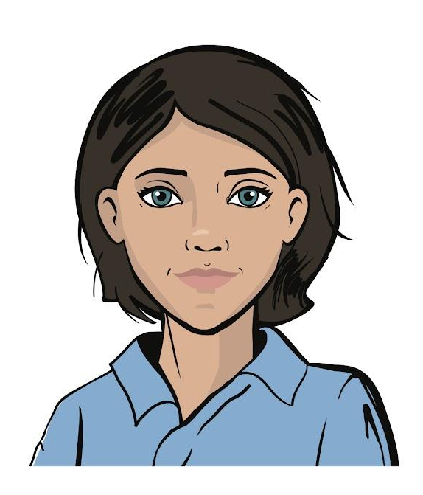
Interesting developer solutions
Even though other ProTeam employees have already thought about the look of Shooter, you can also suggest your own ideas for backgrounds, sprites, and music!
Resources to search:
pixabay.com — free pictures to download
incompetech.com — free mp3 music
Brainstorming

Slide 36
Your tasks:
Program a game template with a picture background.
Set background music.
If time remains, select a place on the scene for the future player sprite.
How do we program this character?
Brainstorming

Slide 37
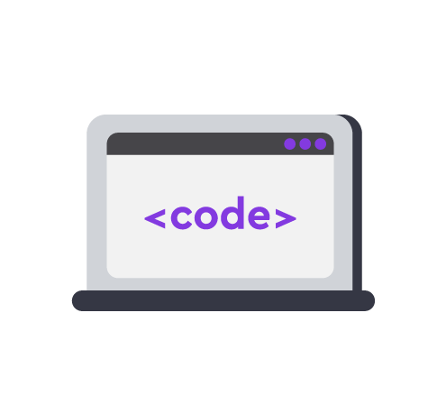
Module 5. Lesson 5. The Shooter game. Part 1
Platform:
Pygame:
Shooter

Slide 38



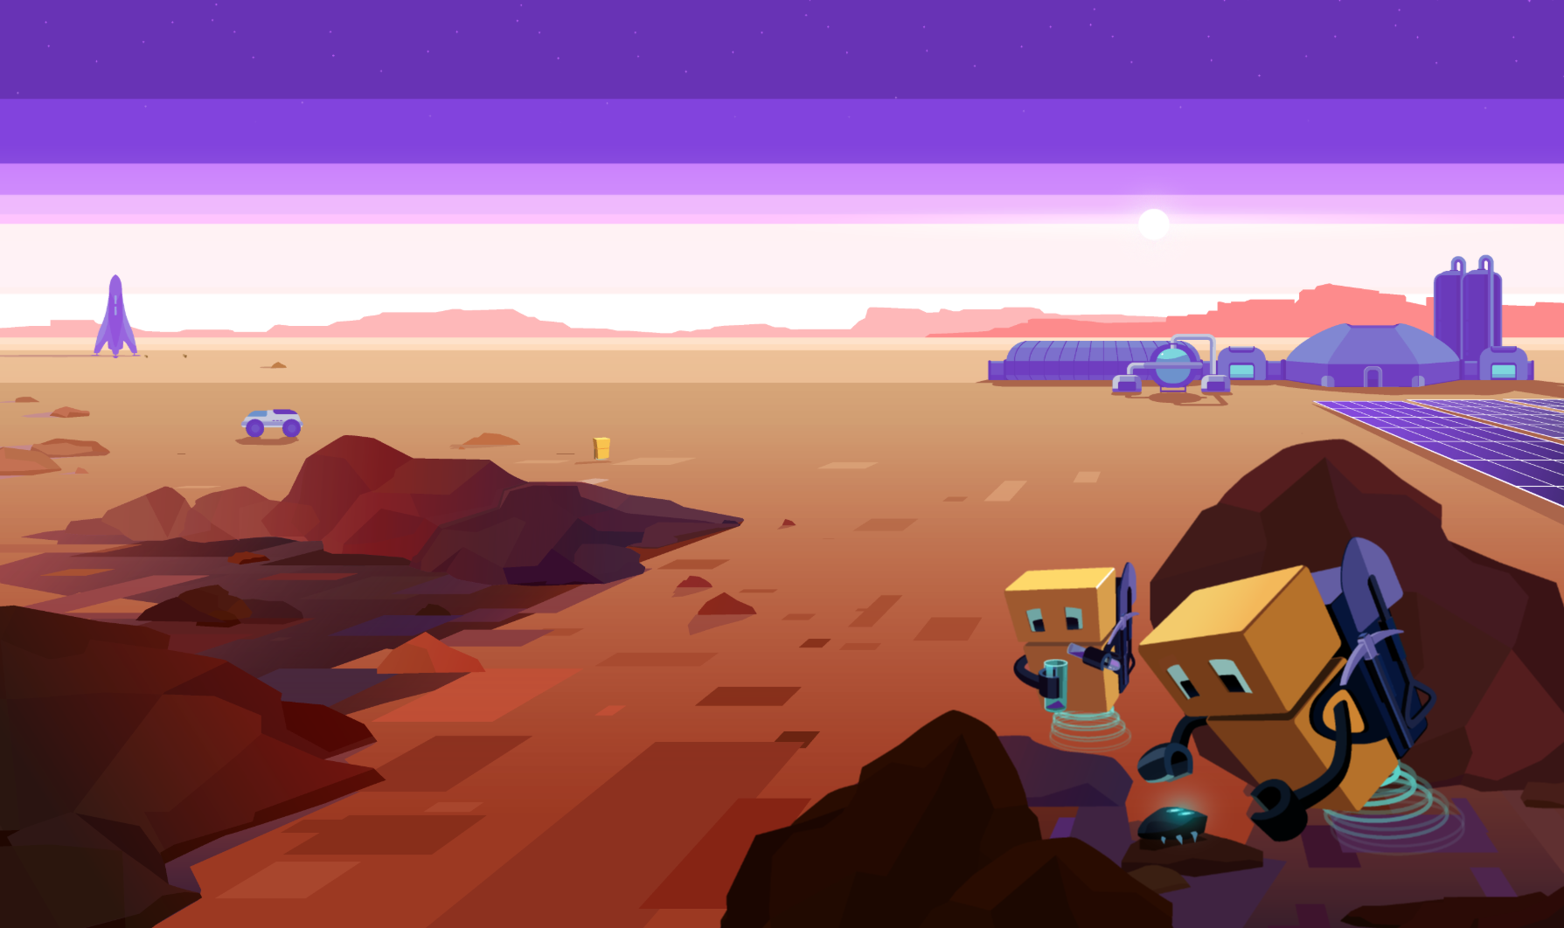
Complete the tasks in VS Code
Pygame: Shooter
Visual Studio Code
Working in
VS Code

Slide 39
Module 5. Lesson 5. The Shooter game. Part 1
Brainstorming:
The Player class

Slide 40
Classes in the Shooter game
There are different types of sprites within the same game: player, enemies, bullets, statistics counters.
What should these sprites be able to do? Do we need to create classes?
Player Sprite
Enemy Sprite
Brainstorming
Do we need corresponding classes?
Bullet Sprite
Counter Sprite

Slide 41
Shooter game classes
Keyboard control
Player Sprite
?
Detects a collision with the enemy
Enemy Sprite
Brainstorming
Bullet Sprite
Counter Sprite

Slide 42
Shooter game classes
Keyboard control
Player Sprite
A child class of Sprite is required
Detects a collision with the enemy
Moves automatically
Enemy Sprite
?
Gets destroyed after touching a bullet
Brainstorming
Bullet Sprite
Counter Sprite

Slide 43
Shooter game classes
Keyboard control
Player Sprite
A child class of Sprite is required
Detects a collision with the enemy
Moves automatically
Enemy Sprite
A child class of Sprite is required
Gets destroyed after touching a bullet
Brainstorming
Moves automatically
Bullet Sprite
?
Disappears after touching an enemy
Counter Sprite

Slide 44
Shooter game classes
Keyboard control
Player Sprite
A child class of Sprite is required
Detects a collision with the enemy
Moves automatically
Enemy Sprite
A child class of Sprite is required
Gets destroyed after touching a bullet
Brainstorming
Moves automatically
Bullet Sprite
A child class of Sprite is required
Disappears after touching an enemy
Doesn't move
?
Counter Sprite
Labels change when other sprites interact

Slide 45
Shooter game classes
Keyboard control
Player Sprite
A child class of Sprite is required
Detects a collision with the enemy
Moves automatically
Enemy Sprite
A child class of Sprite is required
Gets destroyed after touching a bullet
Brainstorming
Moves automatically
Bullet Sprite
A child class of Sprite is required
Disappears after touching an enemy
Doesn't move
No additional class required. We can do with ready-made PyGame objects
Counter Sprite
Labels change when other sprites interact

Slide 46
Shooter game classes
We need to create three classes: Player, Enemy, and Bullet.
While these classes are different, they have a lot in common. For example, the appearance (picture), the method for rendering the sprite on the scene, etc.
Brainstorming
Can we optimize the way these classes are created?

Slide 47
Shooter game classes
Optimization is possible! We used this technique before:
Creating a GameSprite - a child class of Sprite with the required fields and methods.
Creating child classes for different sprites from the GameSprite class.
Properties
Methods
Properties
Methods
Properties
Methods
Brainstorming
Properties
Methods
+
+
Properties
Methods
Described in PyGame
Properties
Methods
+
The Sprite class
GameSprite class adapted for Shooter
Child class for a specific sprite

Slide 48
Shooter game classes
Optimization is possible! We used this technique before:
Creating a GameSprite - a child class of Sprite with the required fields and methods.
Creating child classes for different sprites from the GameSprite class.
Properties
Methods
Properties
Methods
Brainstorming
We can use our developments from the last project!
Properties
Methods
+
Described in pygame
Properties
Methods
+
The Sprite class
GameSprite class adapted for Shooter
Child class for a specific sprite

Slide 49
The GameSprite class
All the parameters the sprites have in common are set in the GameSprite class.
For example: sprite frame, coordinates, speed.
class GameSprite(sprite.Sprite):
def __init__(self, player_image, player_x, player_y, player_speed):
super().__init__()
self.image = transform.scale(image.load(player_image), (65, 65))
self.speed = player_speed
self.rect = self.image.get_rect()
self.rect.x = player_x
self.rect.y = player_y
def reset(self):
window.blit(self.image, (self.rect.x, self.rect.y))
«Мозговой
штурм»

Slide 50
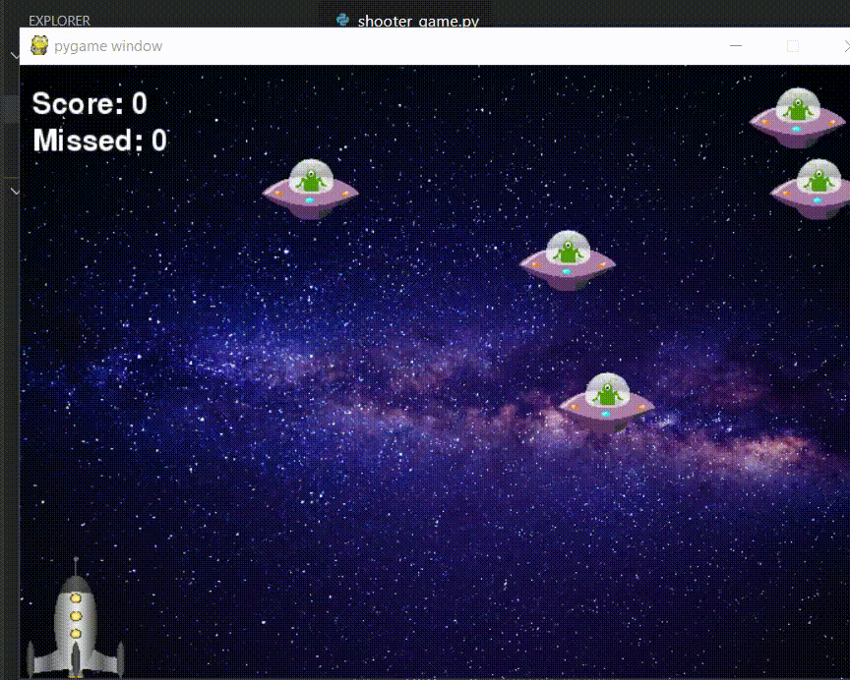
The Player class
Let's start working on sprites with the Player class. The player sprite must be able to:
move when the arrow keys are pressed;
shoot enemies when the spacebar is pressed.
Brainstorming
The player moves.
Upon collision with the enemy, it dies.
The player shoots at enemies.
Upon being hit, the enemy dies.

Slide 51
The Player class
Player is a child class of the GameSprite class:
Constructor
Calling the GameSprite constructor
The Player class
Change position:
key control
with arrows
Brainstorming
Methods
Fire a shot:
bullet creation (?)
A bullet will be an instance of the Bullet class. We don't know yet what it will be like. Let’s come back to this method later.

Slide 52
The Player class
class Player(GameSprite):
# method for controlling the sprite with keyboard arrows
def update(self):
keys = key.get_pressed()
if keys[K_LEFT] and self.rect.x > 5:
self.rect.x -= self.speed
if keys[K_RIGHT] and self.rect.x < win_width - 80:
self.rect.x += self.speed
# the "fire" method
def fire(self):
pass
?
What parameter should a child class have?
?
?
How do we set the arrow keys to control the sprite?
Brainstorming
For now, let's create a method template. We'll write the code later.

Slide 53
The Player class
class Player(GameSprite):
# method for controlling the sprite with keyboard arrows
def update(self):
keys = key.get_pressed()
if keys[K_LEFT] and self.rect.x > 5:
self.rect.x -= self.speed
if keys[K_RIGHT] and self.rect.x < win_width - 80:
self.rect.x += self.speed
# the "fire" method
def fire(self):
pass
We get a set of keys and their status
Checks:
If the Left Arrow is pressed and the left side of the screen has not been reached...
Take a step to the left.
If the Right Arrow is pressed and the right side of the screen has not been reached…
Take a step to the right.
Brainstorming

Slide 54
The Player class
class Player(GameSprite):
# method for controlling the sprite with keyboard arrows
def update(self):
keys = key.get_pressed()
if keys[K_LEFT] and self.rect.x > 5:
self.rect.x -= self.speed
if keys[K_RIGHT] and self.rect.x < win_width - 80:
self.rect.x += self.speed
# the "fire" method
def fire(self):
pass
We inherit from the GameSprite class.
We read a variety of pressed keys and look for the right ones.
We restrict the movement to the size of the window!
Brainstorming

Slide 55
Game loop for the Shooter game
Creating classes, interface...
We should supplement the game loop with a new finish variable (responsible for the status of the game, but does not force the application to close).
finish = False — the game is not over
run = True — the application is working
No
Is run not equal
to False?
Yes
Brainstorming
No
Yes
Is the ‘Close Window’ button pressed?
run = False
No
Is finish not equal to True? (win or lose)
Yes
Displaying background, characters, etc.

Slide 56
Program workflow:
The result is a game scene with background music and a player sprite.
GameSprite class description
Player class description
Creating objects for the background and music
Creating a player sprite
«Мозговой
штурм»
Game loop:
Closing the application if the "Close window" button is pressed
Finishing the game if a win or loss occurs
Rendering the scene and sprites on it
Updating the scene

Slide 57
Your tasks:
Implement the Player class using the previous project's GameSprite class developments.
Change the game loop: separate the closing of the game window and the win/lose situations.
Create and position the player sprite.
Brainstorming

Slide 58
Module 5. Lesson 5. The Shooter game. Part 1
Platform:
PyGame:
Shooter

Slide 59
Complete the tasks in VS Code
PyGame: Shooter
Visual Studio Code
Working in
VS Code

Slide 60

Module 5. Lesson 5. The Shooter game. Part 1
Wrapping up
the work day

Slide 61

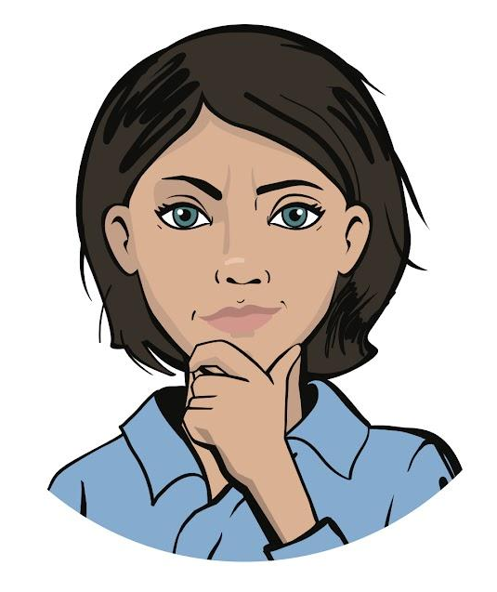
Let’s end the work day by answering these technical questions:
What class hierarchy did you create for the Shooter game? Were you able to take advantage of past developments?
Describe how the Shooter game loop works. Why does it have two variables responsible for its operation?
Wrapping up
the work day
Cole,
senior developer
Emily,
project manager

Slide 62
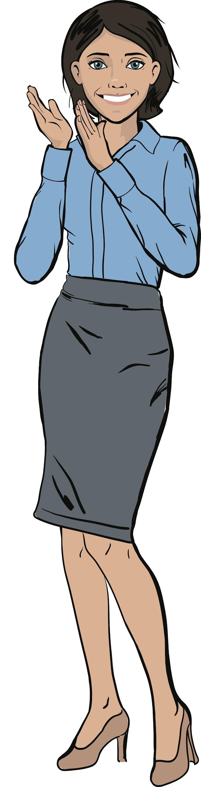
Excellent work!
Colleagues,
You did a great job today.
We will continue working on the Shooter game and create enemy sprites on our next work day!
Wrapping up
the work day

